Slide 1
Team Task: Server VM
By: Carlos Gerez Garcia, Christopher Ditto, and Mark Riley Slik

Slide 2
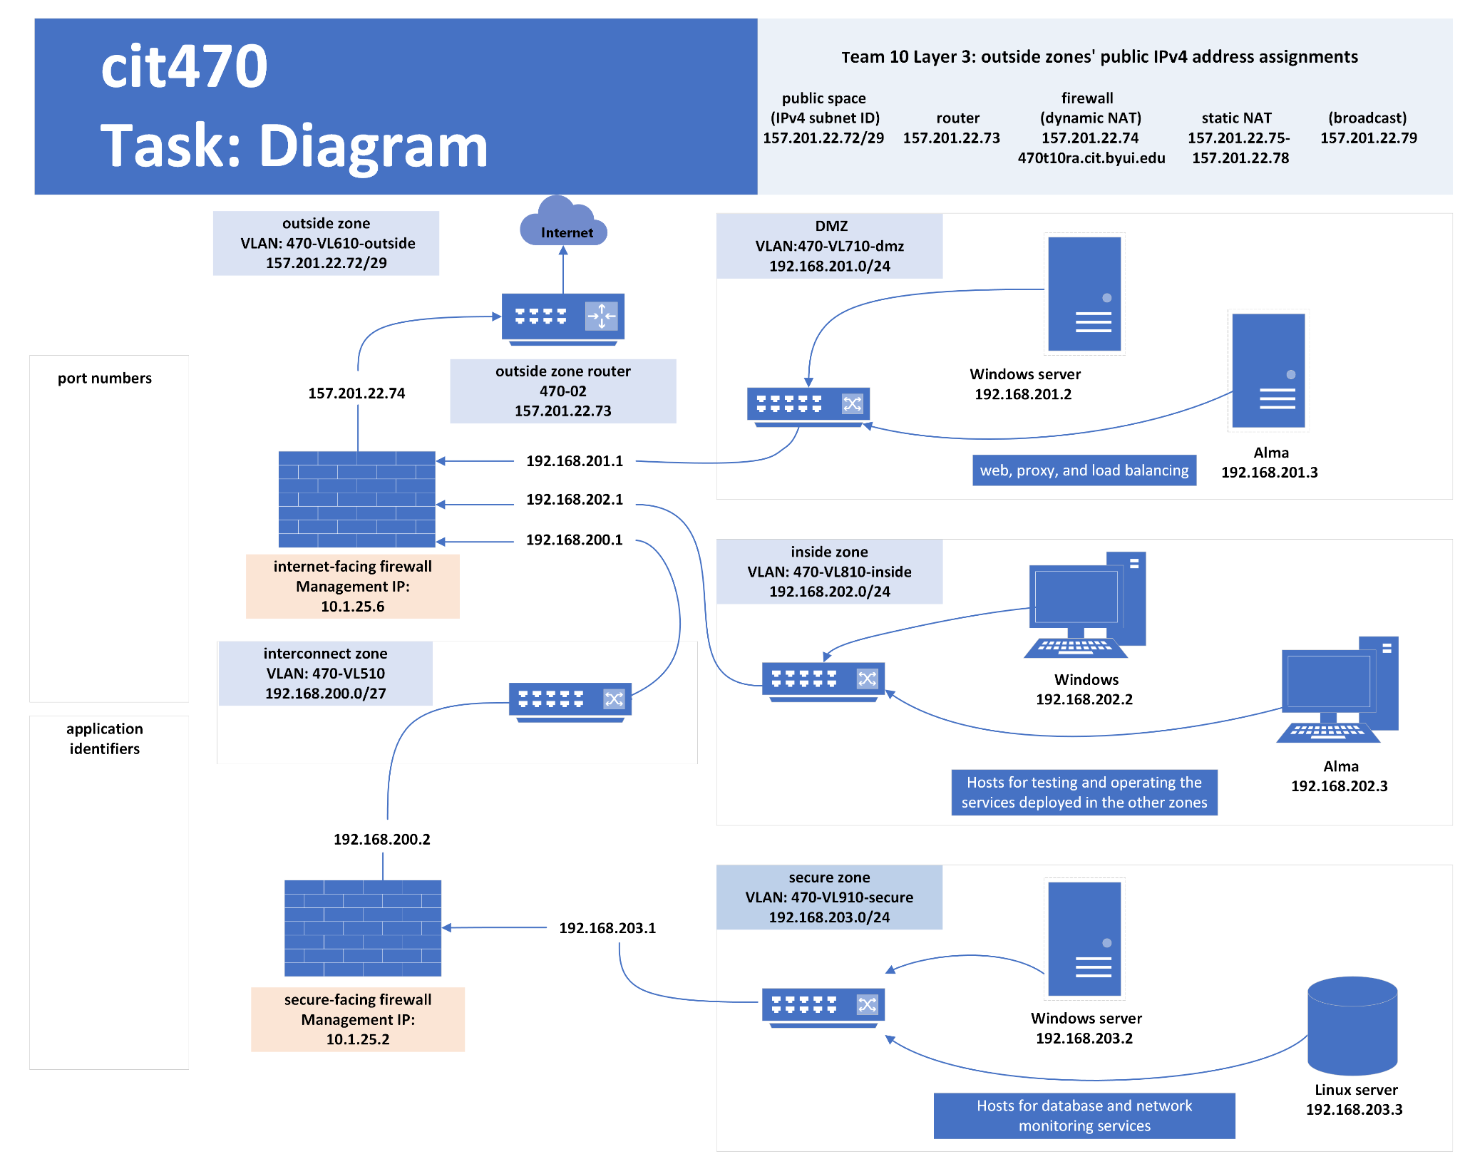
Diagram Outline for Team 10

Slide 3
Zone Information

Slide 4
Secure Zone
Vlan: 470-VL910-secure
192.168.203.0/24
Gateway 192.168.203.1
Windows server 192.168.203.2
Linux server 192.168.203.3

Slide 5
Inside Zone
Vlan: 470-VL910-secure
192.168.202.0/24
Gateway 192.168.202.1
Windows server 192.168.202.2
Alma server 192.168.202.3

Slide 6
DMZ
Vlan: 470-VL910-dmz
192.168.201.0/24
Gateway 192.168.201.1
Windows server 192.168.201.2
Alma server 192.168.201.3

Slide 7

Startup
The following instruction work for any zone, but in our examples we are setting up a Secure zone with the exception of the Alma server which is setup in a different zone. These instructions work for any zone you just need to add in your own info.

Slide 8
How to Setup a Windows Server

Slide 9
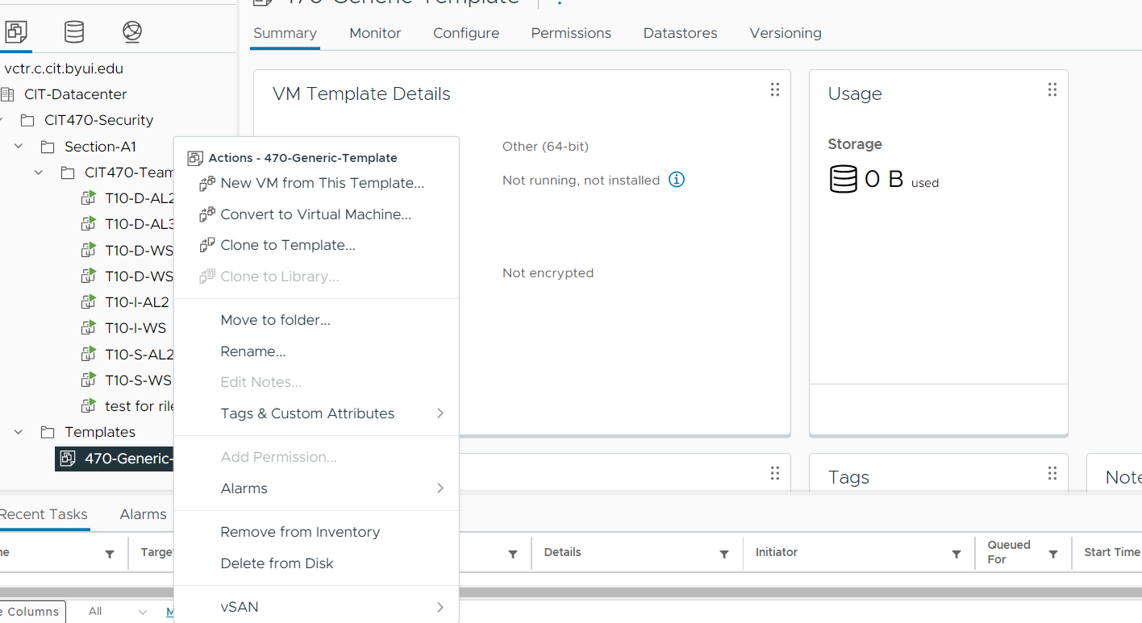
Step 1. Startup select
Inside of Vsphere right click the 470-Generic-Template and choose new Vm from this Template

Slide 10
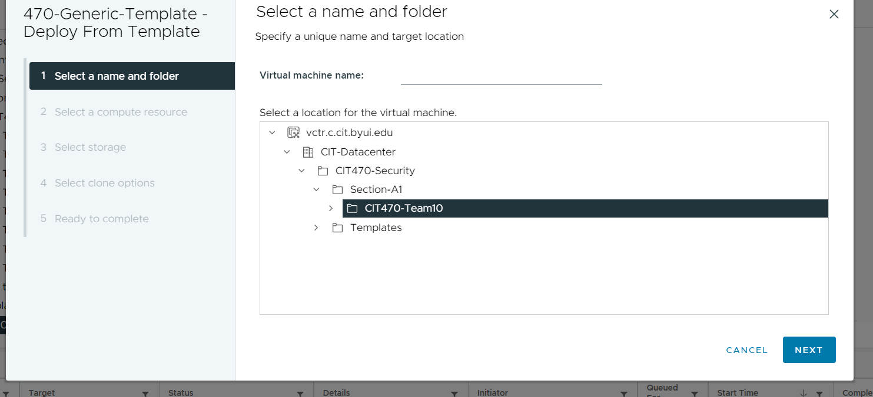
Step 2. Location and name
Choose your teams section inside of class of CIT 470. You must also name the VM as well make sure to agree with team before on a name scheme used for these server like T10-S-WS

Slide 11
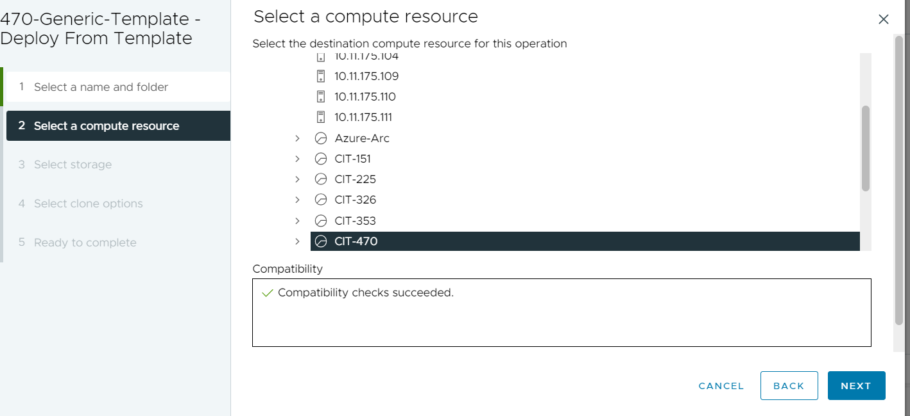
Step 3.Resource Allocation
The next step is select where the VM will pull resources from. Please make sure to select your correct class.

Slide 12
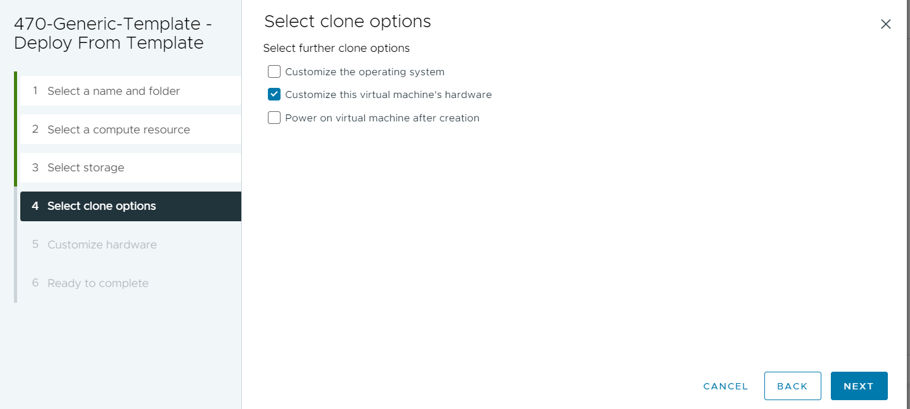
Step 4. Clone options
In this step you need to select Customize this virtual machines hardware so we can ensure it has the proper settings.

Slide 13
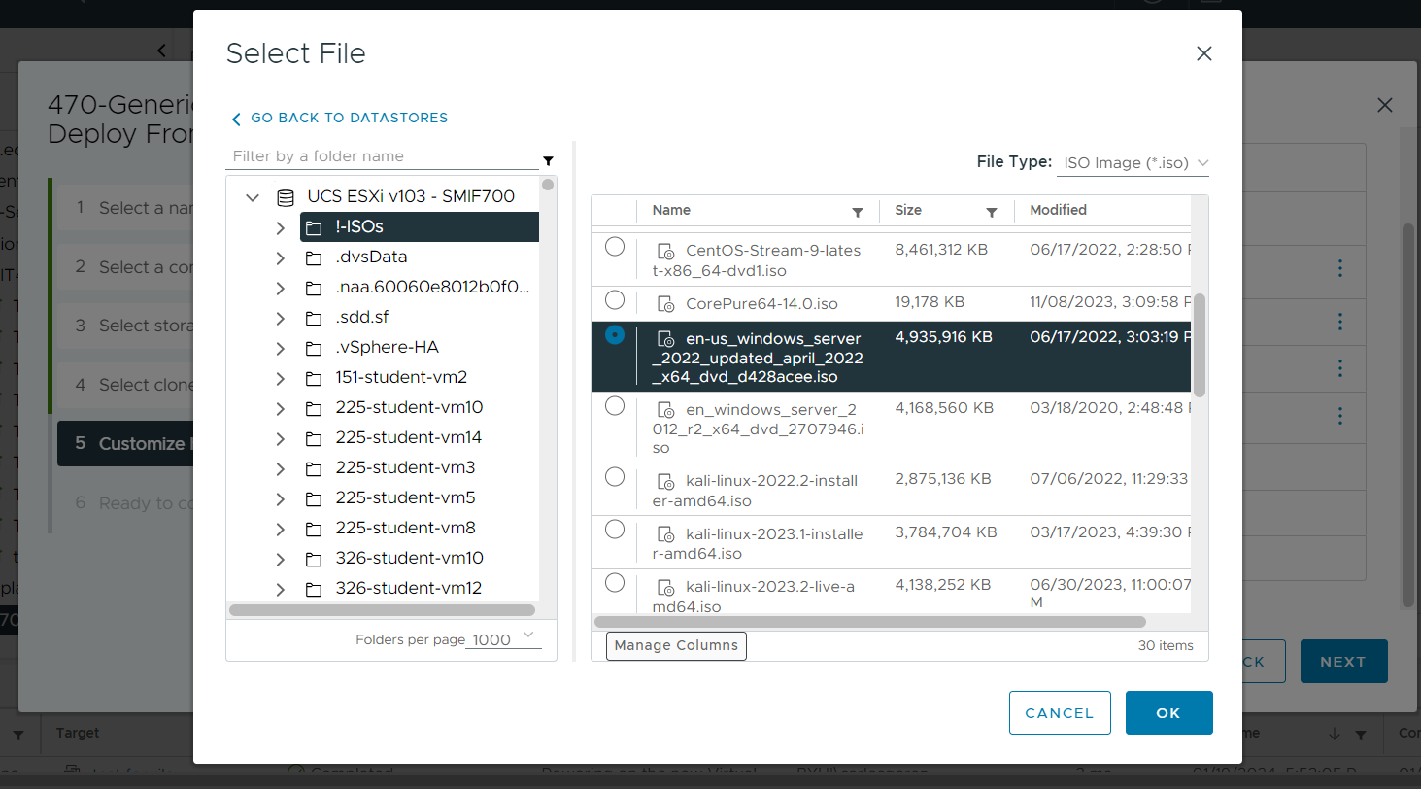
Step 5. ISO selection and other settings
After allowing the VM to be customized you will be shown screen with many different options . There are only three sections you need to worry about the SCSI controller needs to selected as “LSI Logic SAS.” the network adapter needs to match the correct zone and finally ISO for your machine , there many options you can browse inside the CD/DvD media but in this example we select the 2022 windows server.

Slide 14
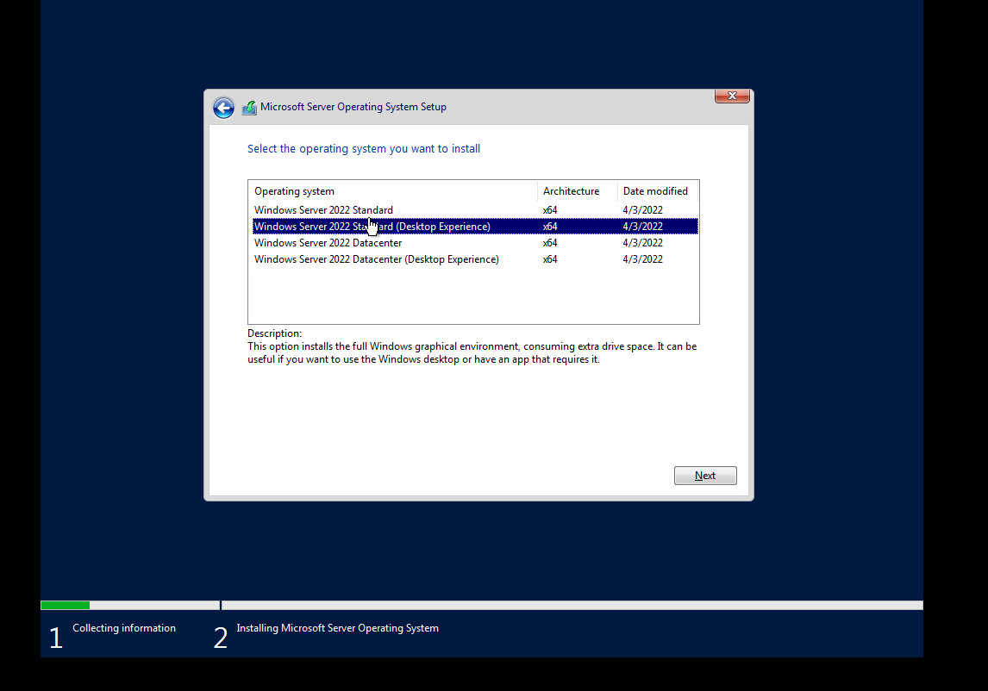
Step 6. Installing the OSI
Power on the newly made VM and start the install process. Follow the prompts until you get to the window asking for a product key, select I don’t have a product key. This will take you too system setup window. You most choose which version of windows server 2022 you are going to install, select the standard desktop experience.

Slide 15
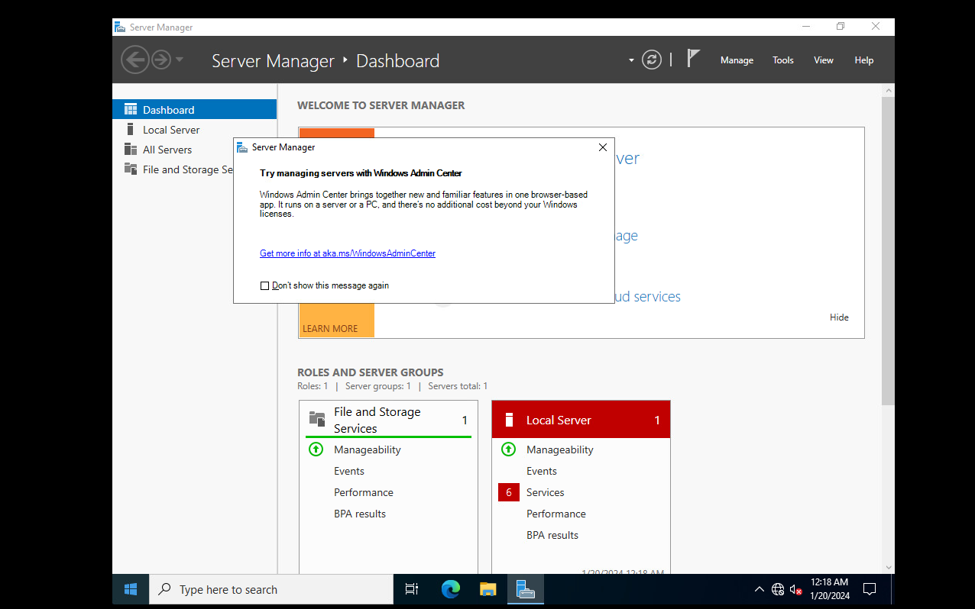
Step 7. Finish install
After choosing the version of windows server 2022 you need to accept the terms and condition and select custom install for how you wish to install this OSI. After all this you will finally be able to make an admin account and get into the OSI once you do you should locate the server manager.

Slide 16
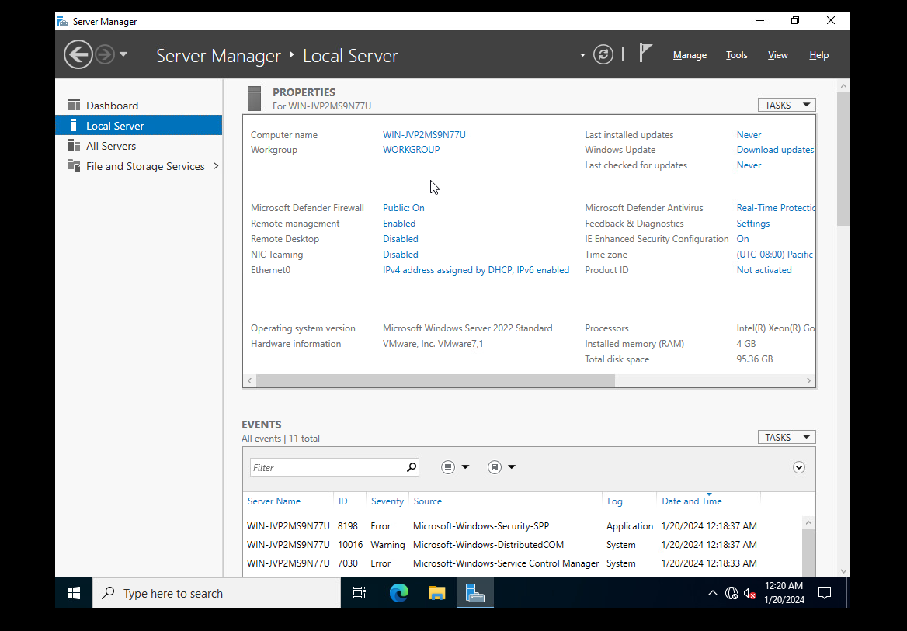
Step 8A. Server Manager
Select Local Server and disable and enable these setting. Allow Remote connections but turn off network level authentication. Next disable IE enhanced security

Slide 17
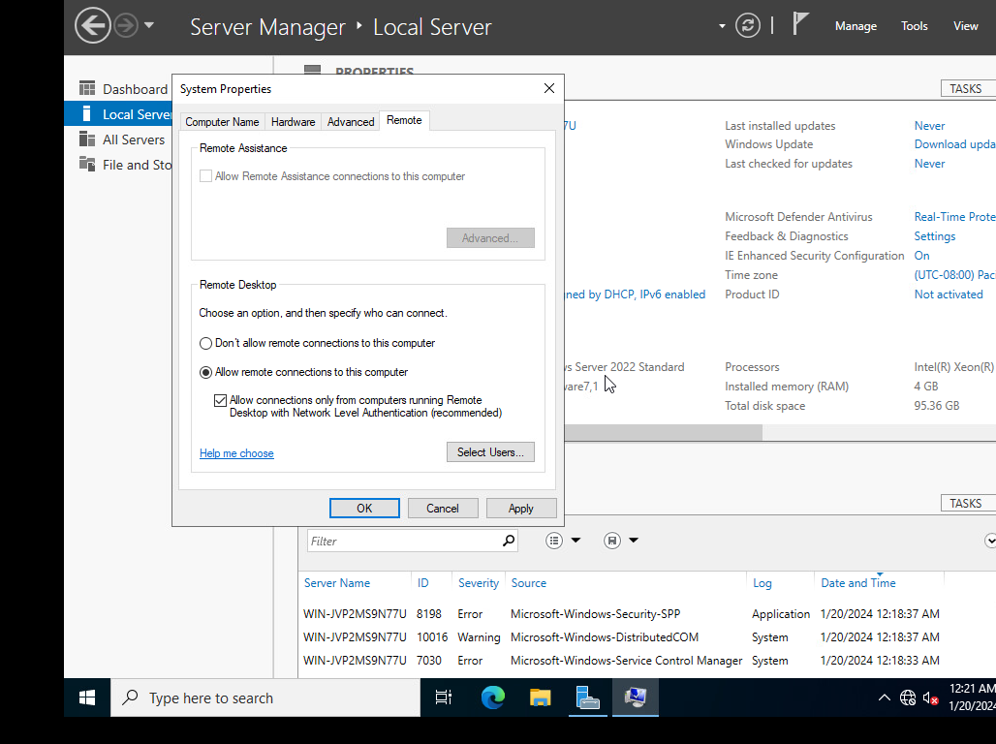
Step 8B.

Slide 18
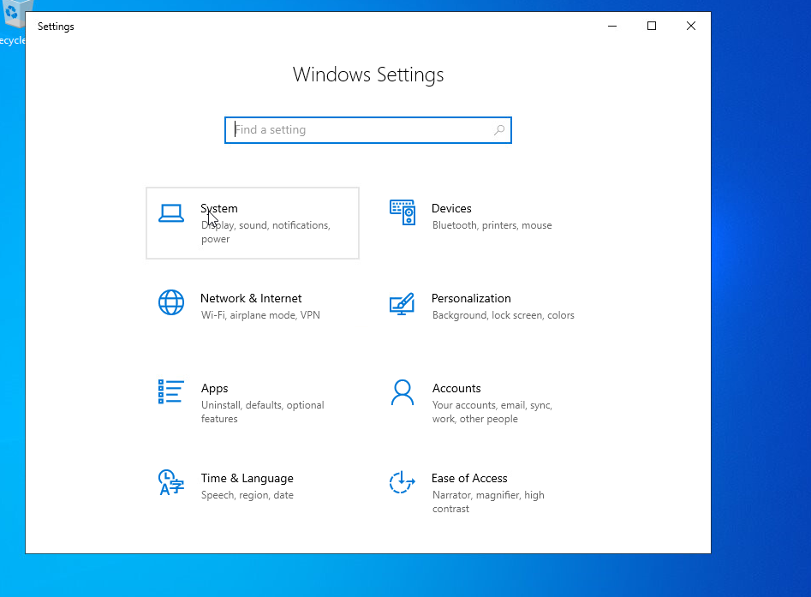
Step 9. Windows setting
The next step we going to change a few setting inside of windows setting. These changes will be made in System , Network & Internet, and Accounts. The first change will be in Accounts.

Slide 19
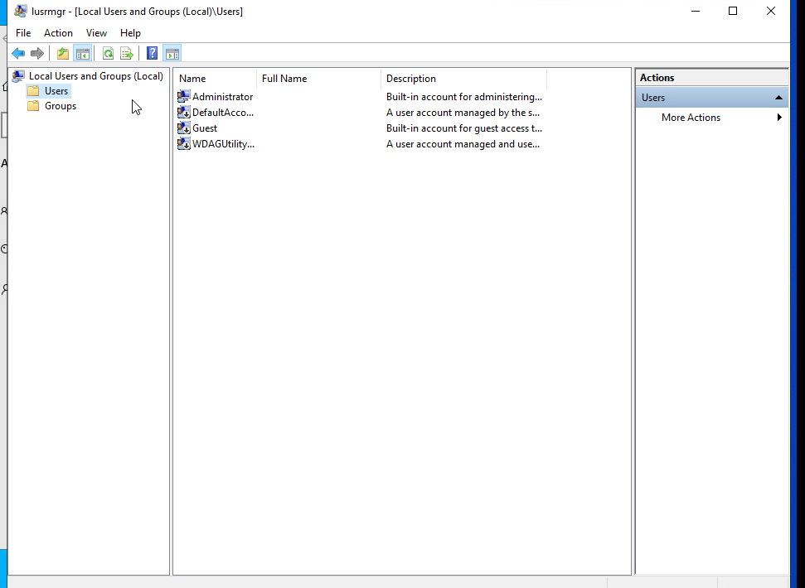
Step 10. Adding new users
Select Accounts and then other users. Inside of that window will be an option to add a new user. It will take you to new window with several options. In this window you need click on the actions tab and select create new user. Take this time to make a user for everyone in your group and set a password for the account.

Slide 20
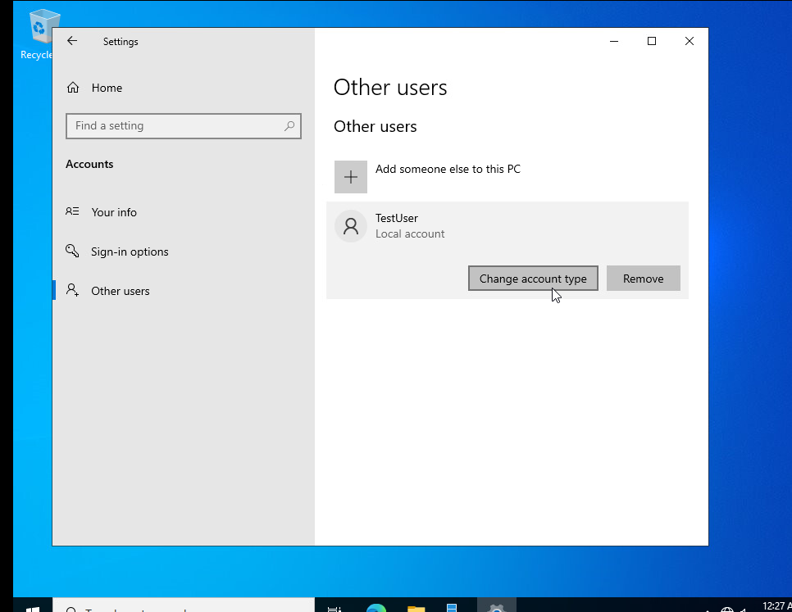
Step 11. Change Account Type
Back in the other windows in the accounts section you need to switch all the new user account types to Administrator so that you and your team can work on this machine as admins.

Slide 21
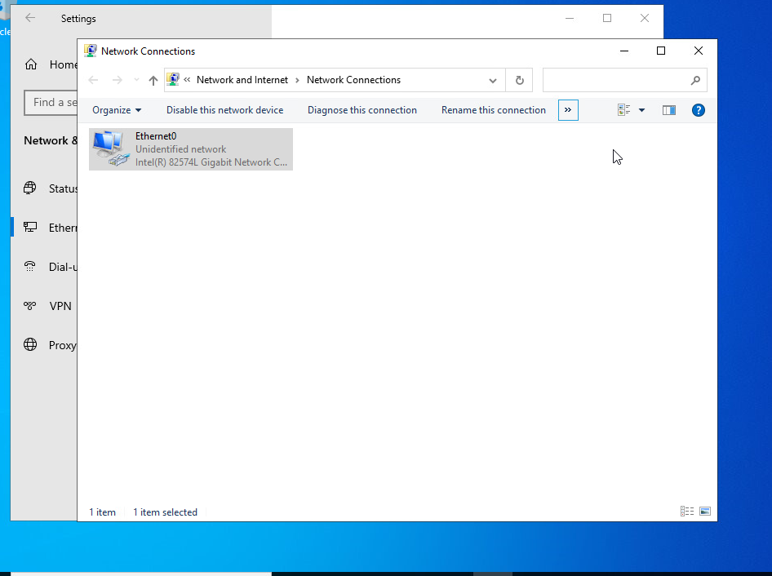
Step 12A. Ethernet and Internet settings
Now you need to back to window from step 9 and select the Ethernet and Internet option in there will be a section called Ethernet, click on it and look for the option highlighted in called Change Adapter options . It will take you too this window.

Slide 22
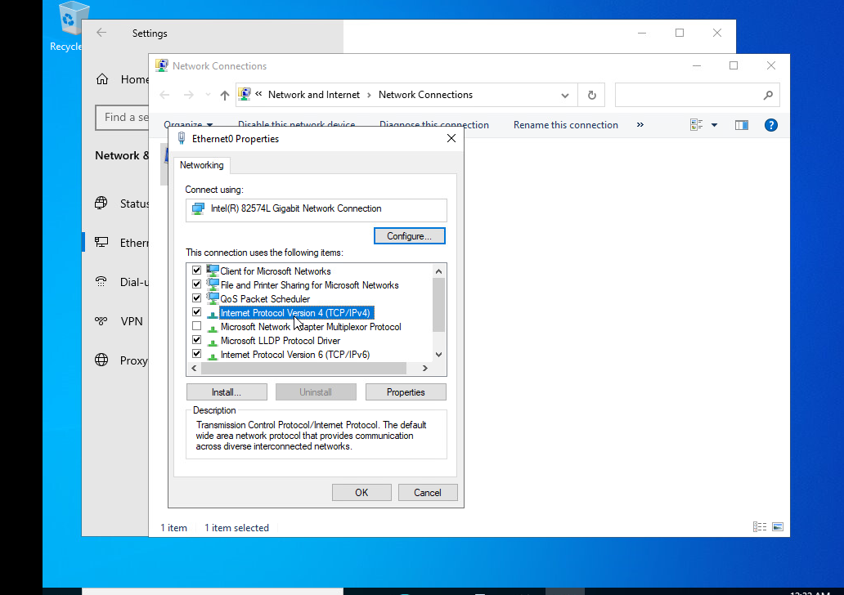
Step 12B. Changing Ipv4
In this window you need to click on the double arrows next to rename this connections. It will open a smaller window, in this smaller window you need to select Ipv4 and click on properties

Slide 23
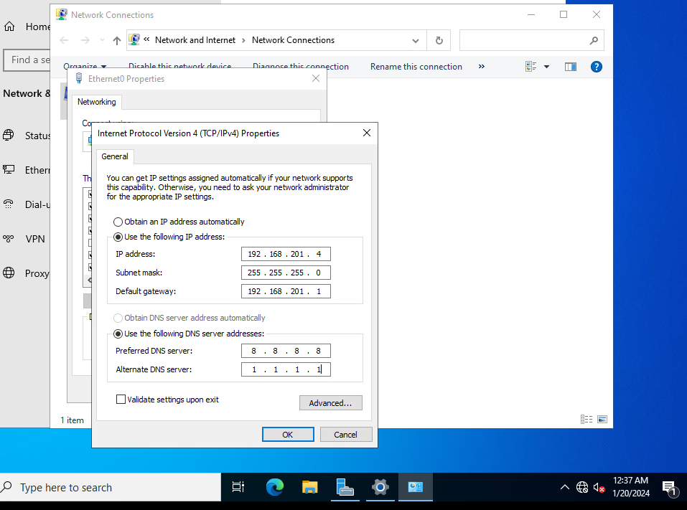
Step 12C. Setting Ip Address.
If you have follow the instructions you will see a new window that will give you the option to set this servers address. Fill out the Ip address that your team agreed upon before starting this assignment. Also fill out the subnet and default gateway from your teams diagram. You don’t need to fill out the DNS right now but can choose to if you feel like it.

Slide 24
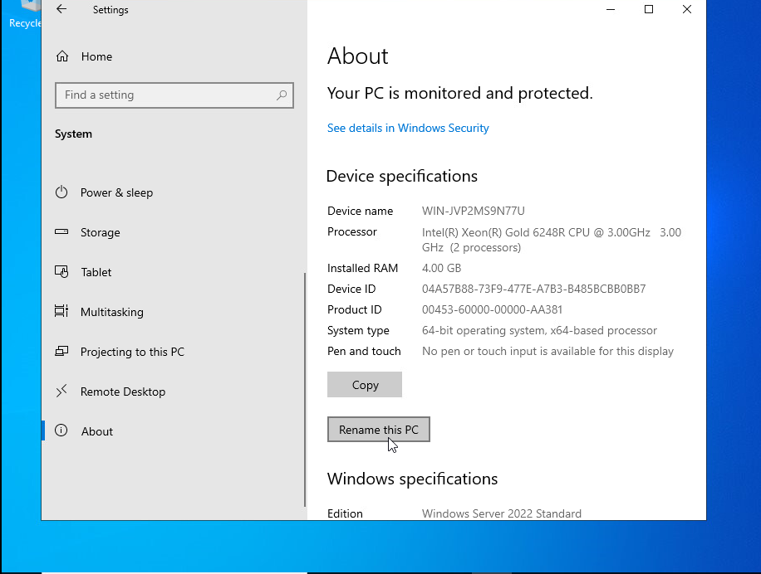
Step 13. Rename the device
Going back to step 9 click on the system icon and scroll down until you see the about page. Inside of here will be an option to rename the PC, you will need to rename this device to match what you called the VM , this will cause the VM to restart. This is last step you need to do for now but later you will need to ping this device.

Slide 25
How to Setup an Alma Server

Slide 26
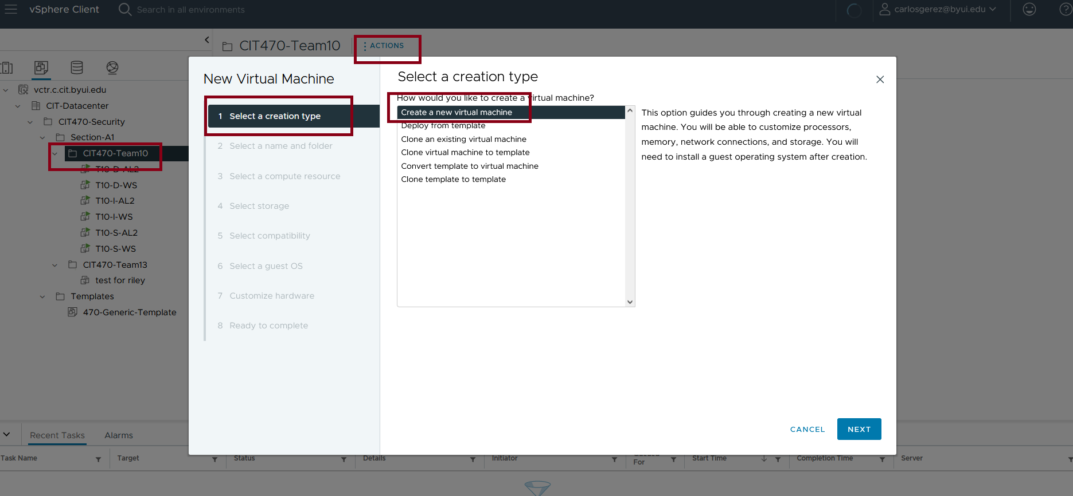
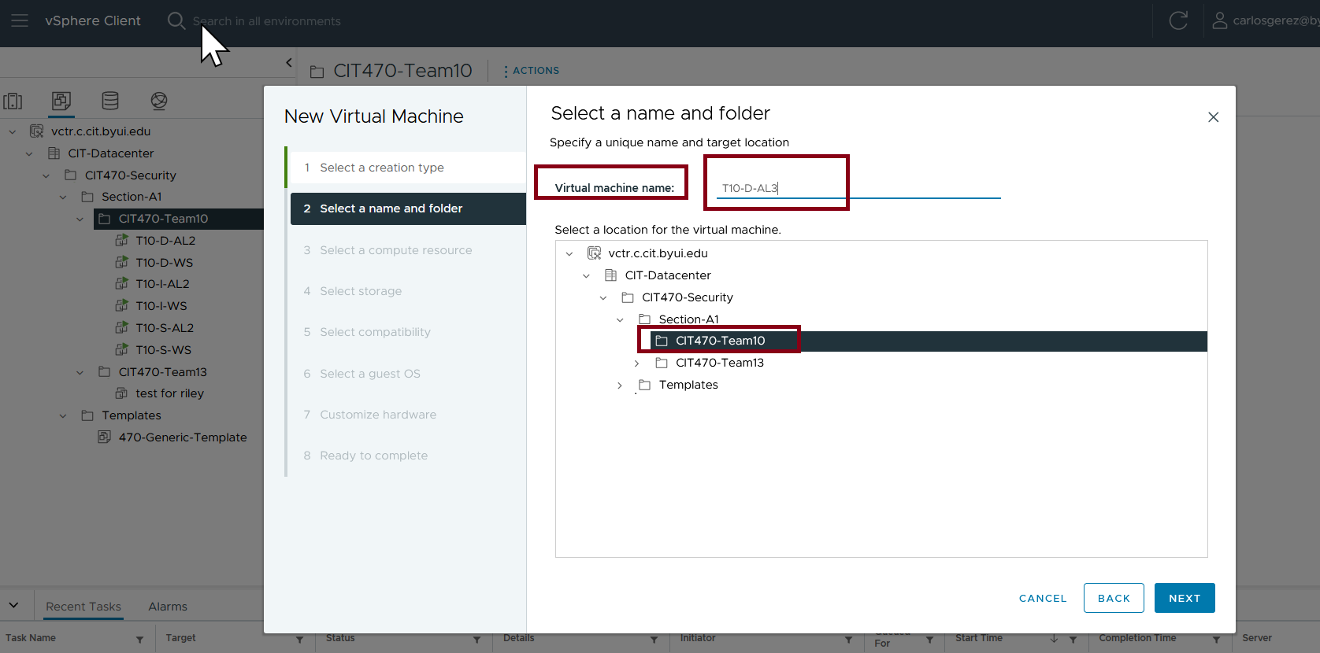
Step 1.
Click on Actions and select Create a new virtual machine
Give the new machine a name according to the teams chosen naming schematic. In this case it is T10-D-AL3

Slide 27
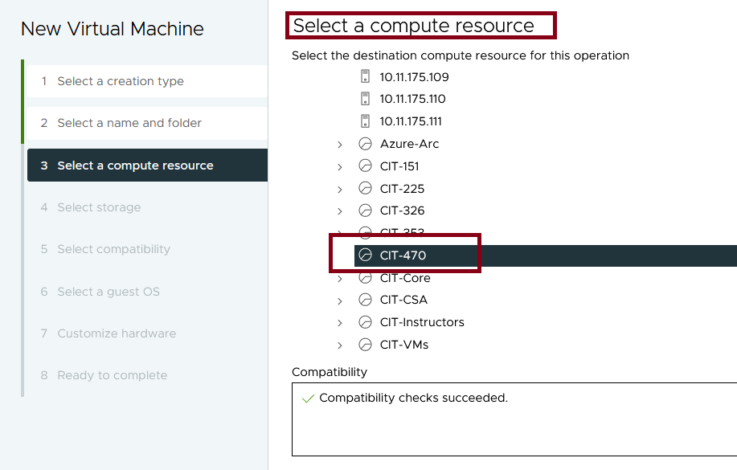
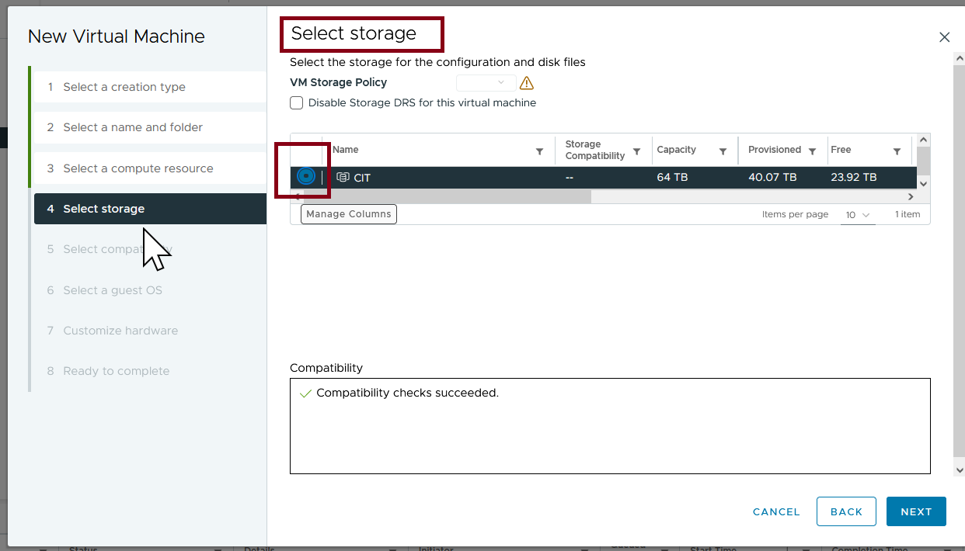
Step 2.
Select CIT-470 as the compute resource then select CIT as the storage area

Slide 28
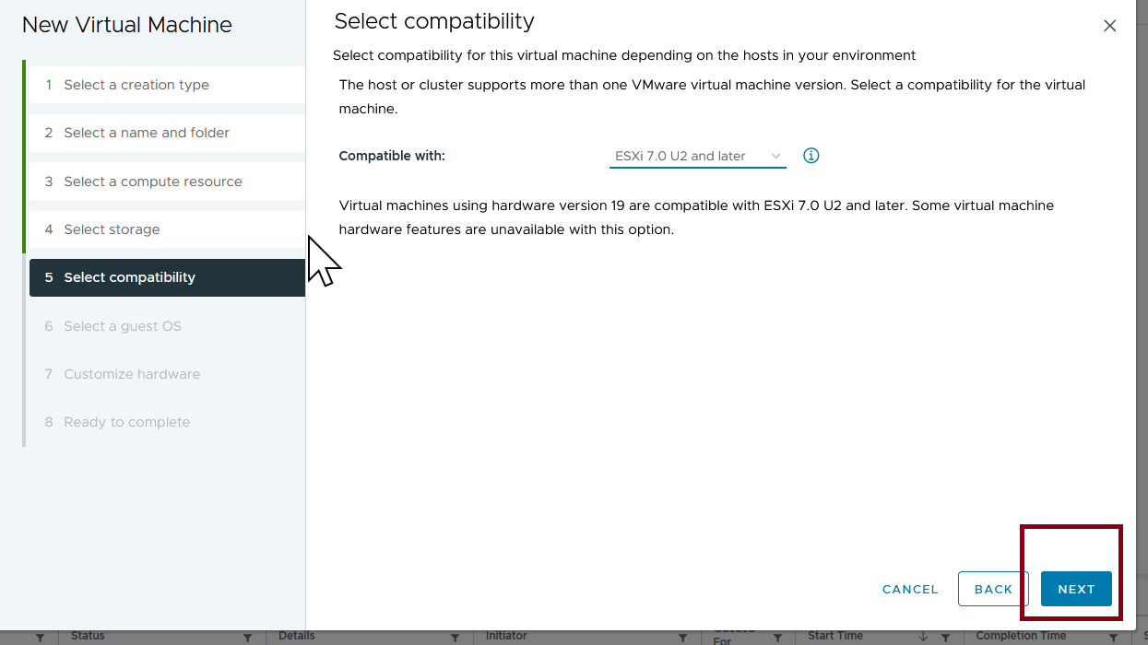
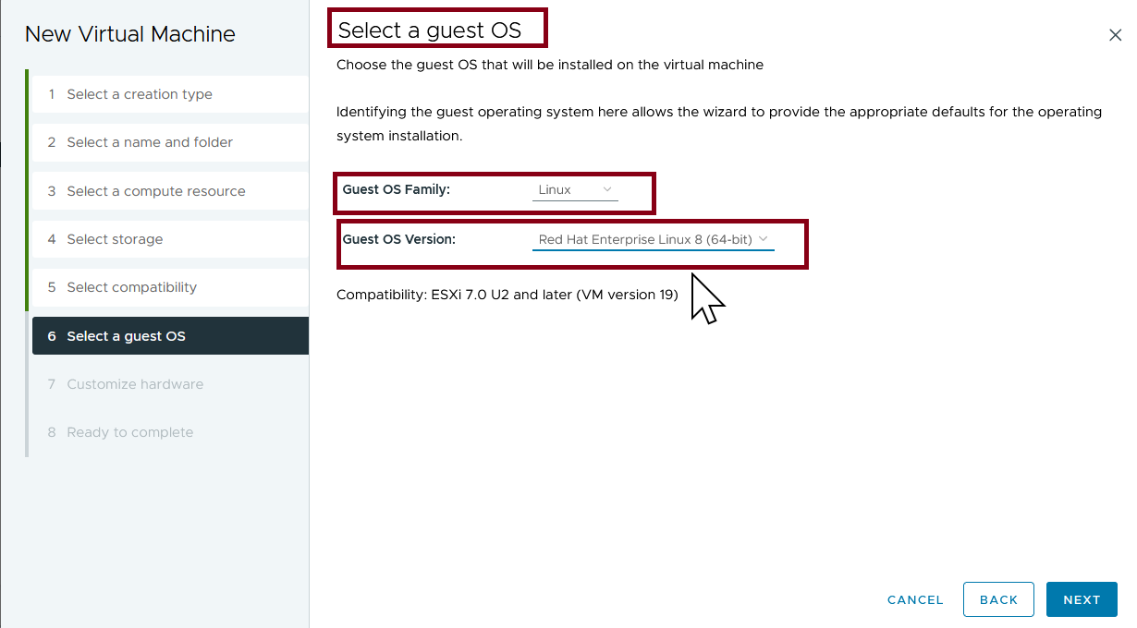
Step 3.
Select compatibility to ESXi 7.0 U2 and later
Select Linux as the guest OS Family and RedHat Enterprise Linux 8 (64-bit) as the Guest OS Version

Slide 29
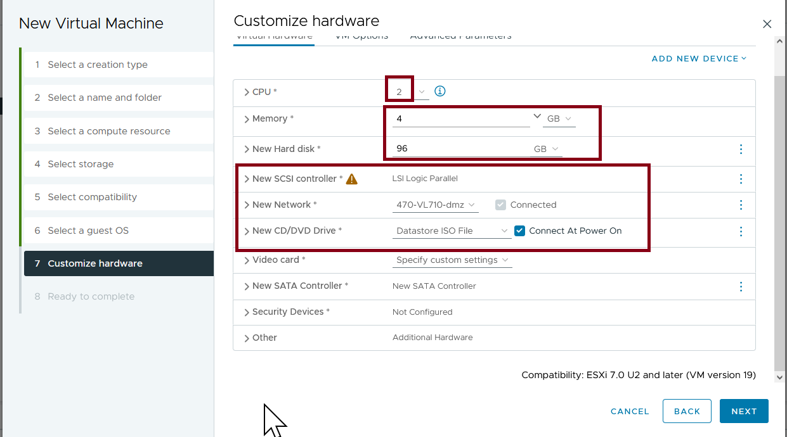
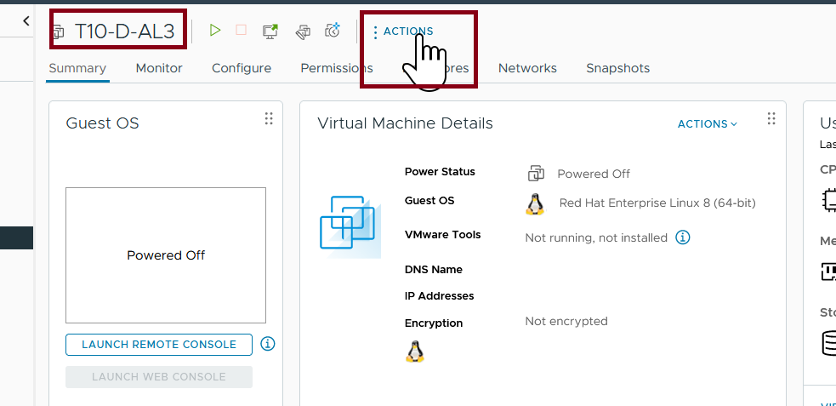
Step 4.
Customize hardware settings and check the Connect At Power On box
Select NEXT and then FINISH

Slide 30
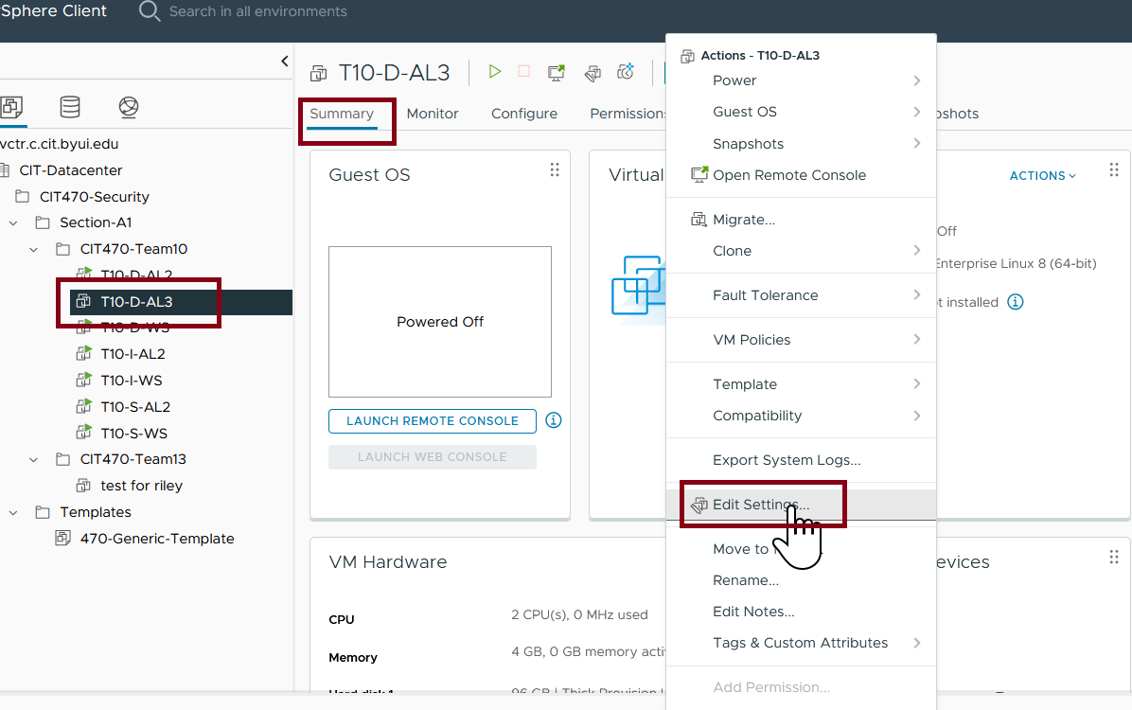
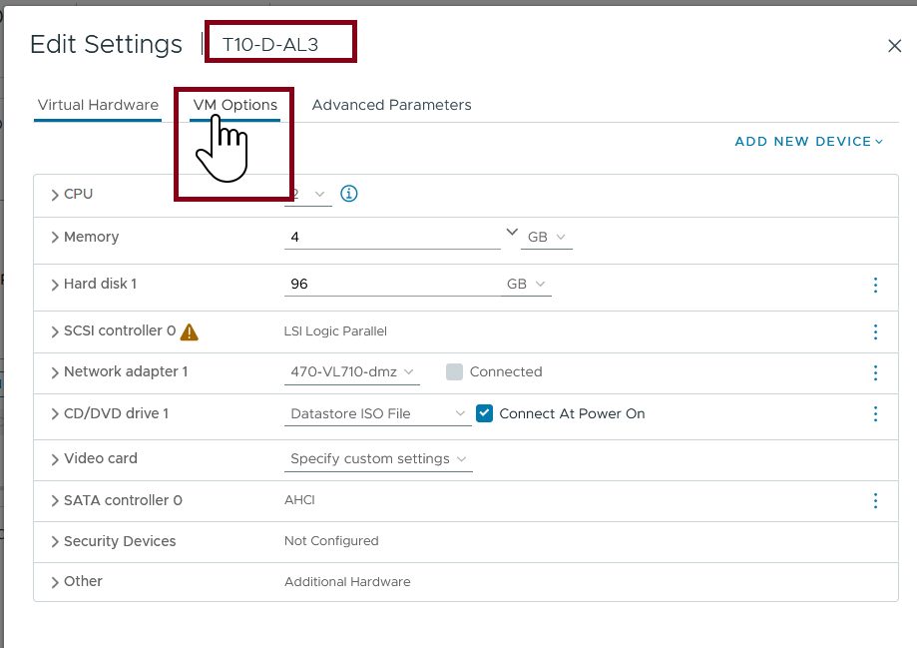
Step 5.
Under Summary open the Actions menu and select Edit Settings
Select the VM options Tab

Slide 31
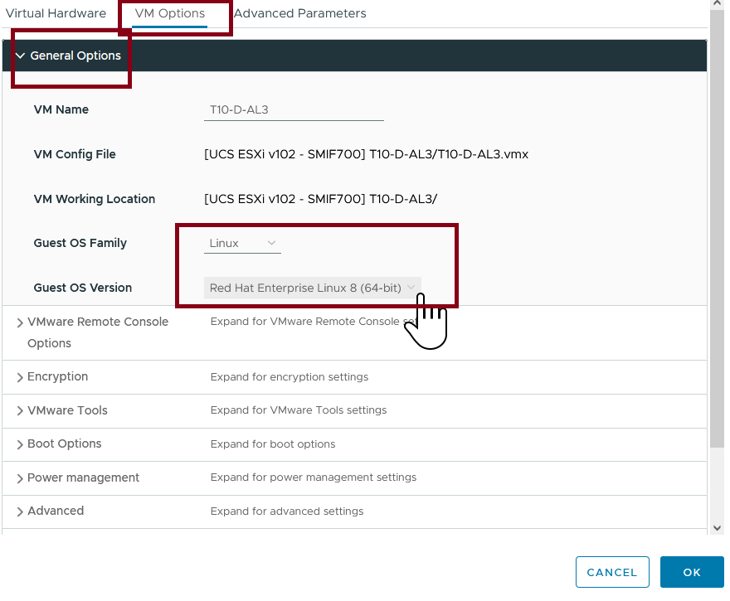
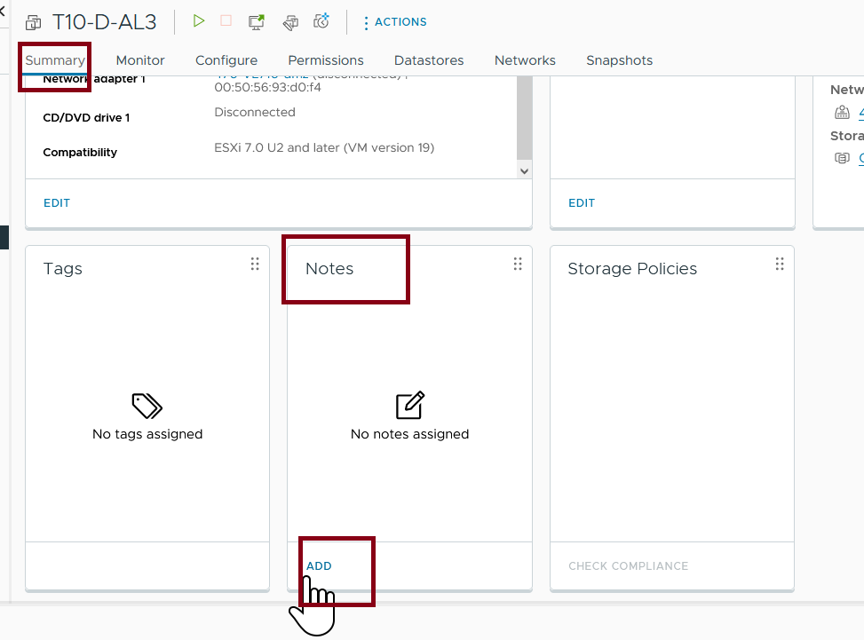
Step 6.
Under General Options, Select Guest OS family and select Linux then Under Guest OS Version select Red Hat Enterprise Linux 8 (64-Bit) Click OK
Under the Summary tab, scroll down to the notes section and click ADD

Slide 32
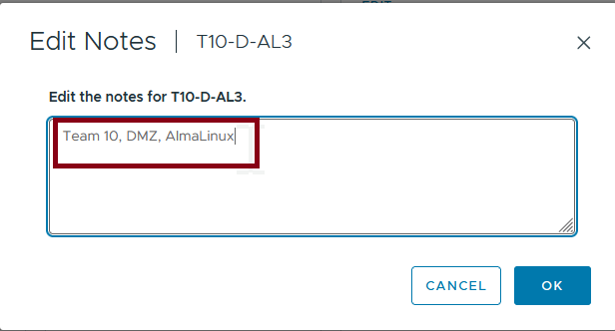
Step 7.
Enter the Team name, Zone, and OS

Slide 33
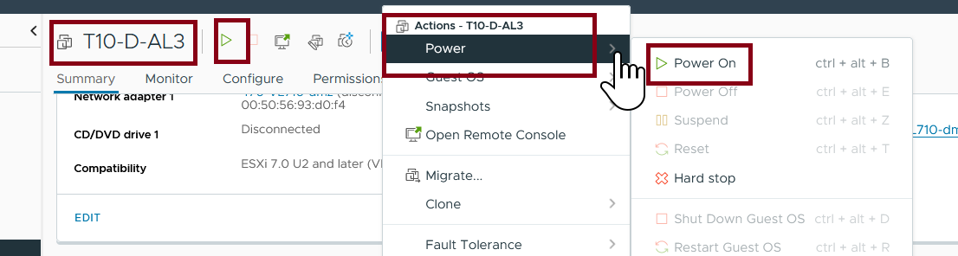
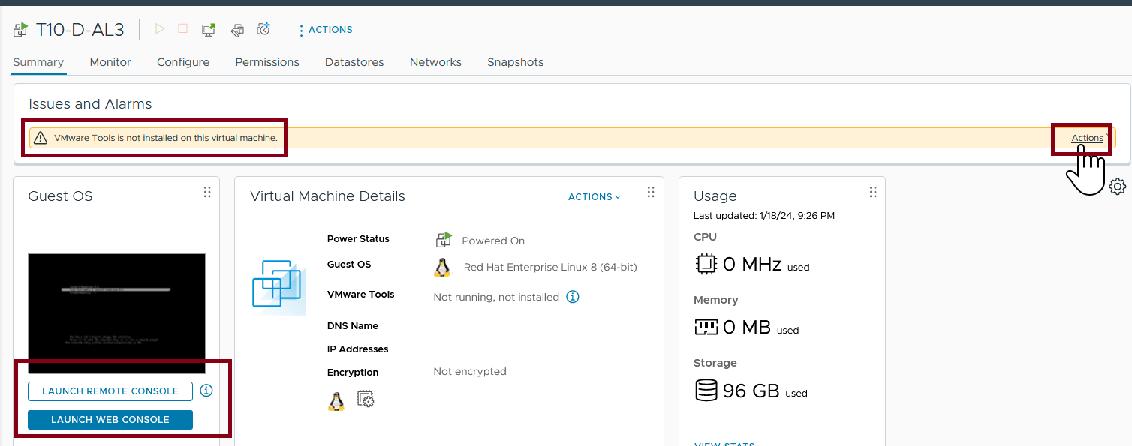
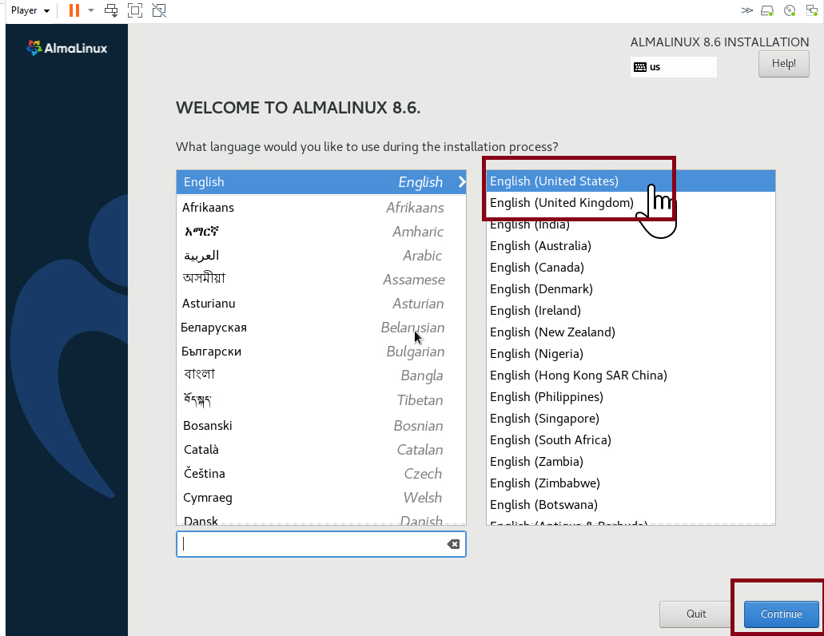
Step 8.
Power on the machine
When the vmWare tools is not installed warning pops up, click actions and then install vmware tools
Choose a language and click next

Slide 34
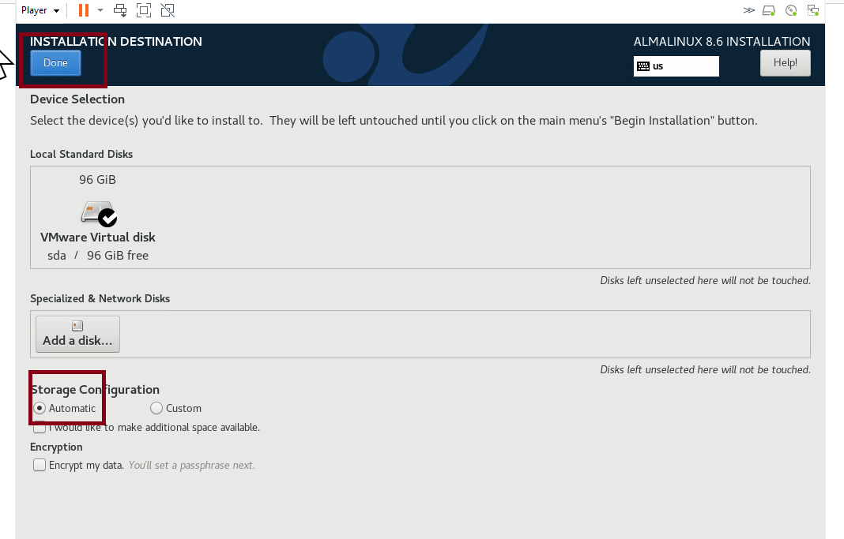
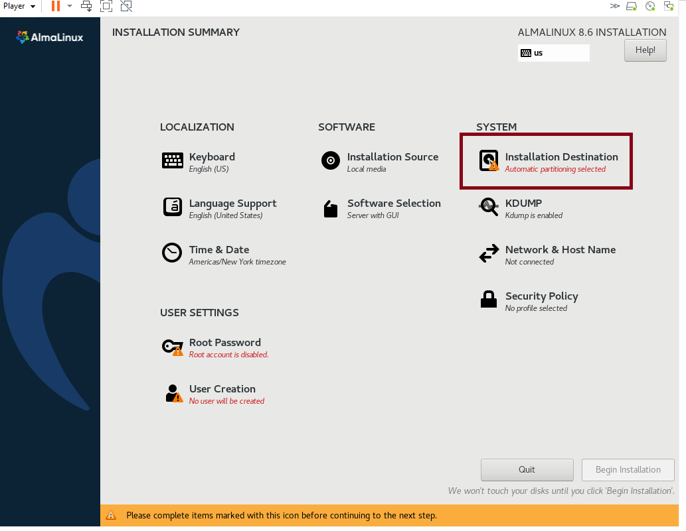
Step 9.
Click on Installation Destination
Set Storage Configuration to Automatic and click done

Slide 35
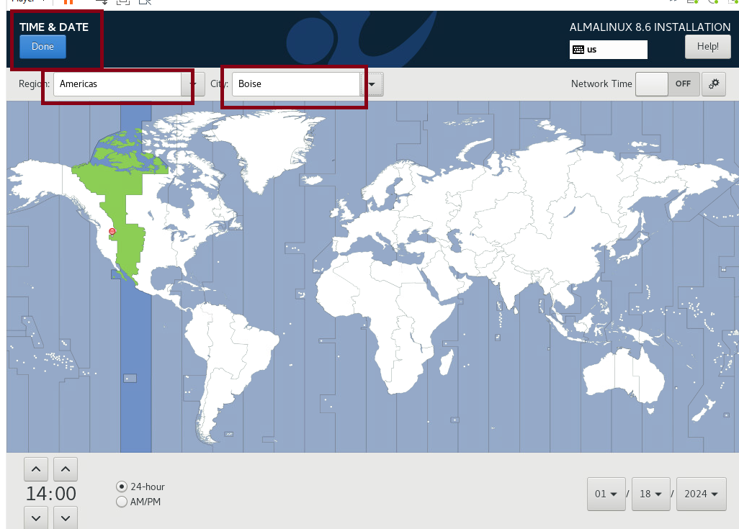
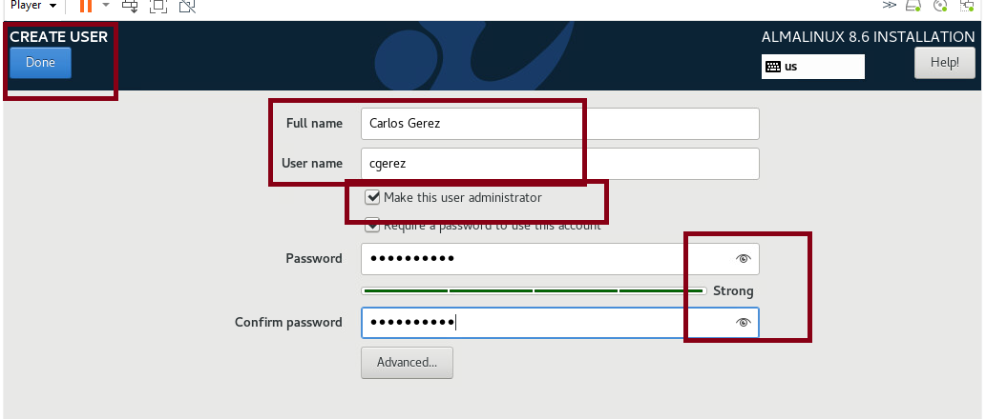
Step 10.
Select Time Zone
Create a user by filling in the needed information and checking the make Administrator box.
Make sure to create a strong password

Slide 36
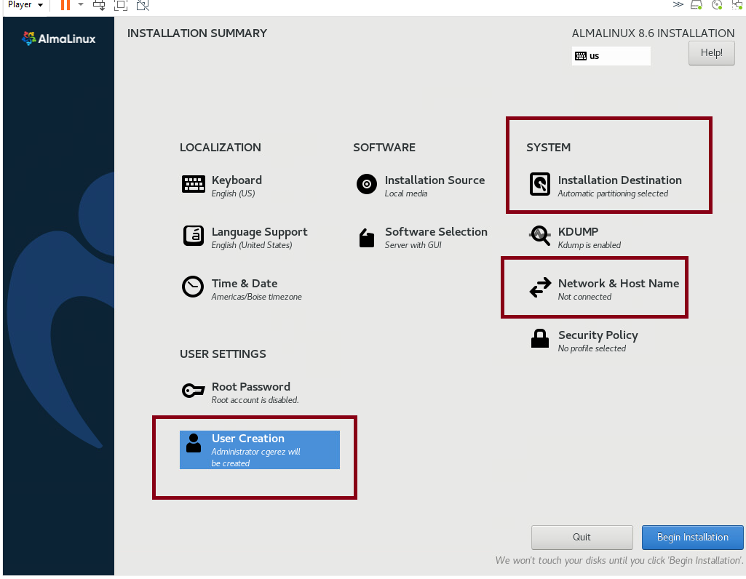
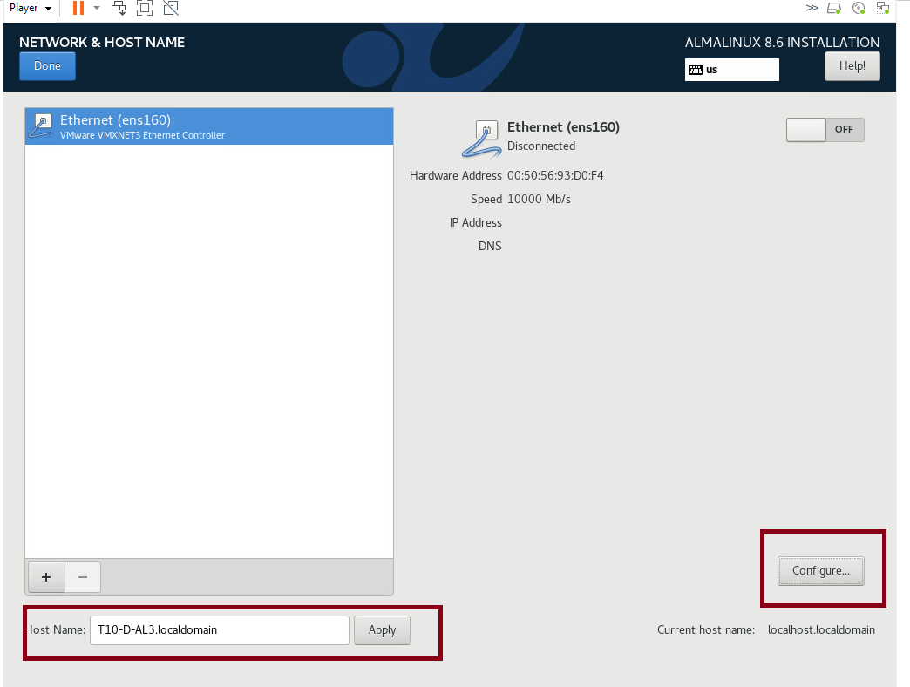
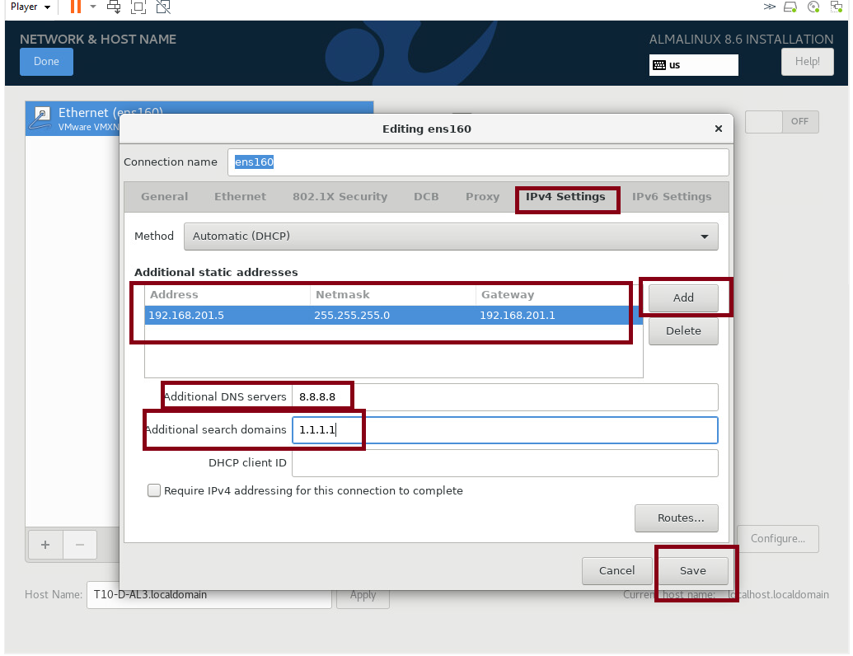
Step 11.
Click on Network & Hostname add the (machine name).localdomain to the host name field, click apply, and then click on Configure
Select IPv4 setting and add ip address, netmask, gateway then click Add
Add DNS addresses then click next

Slide 37
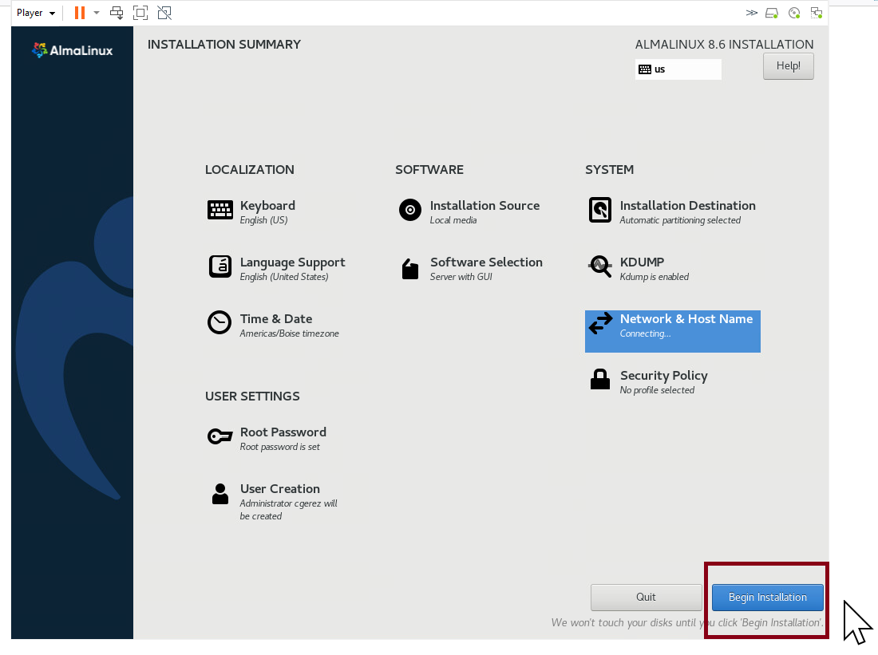
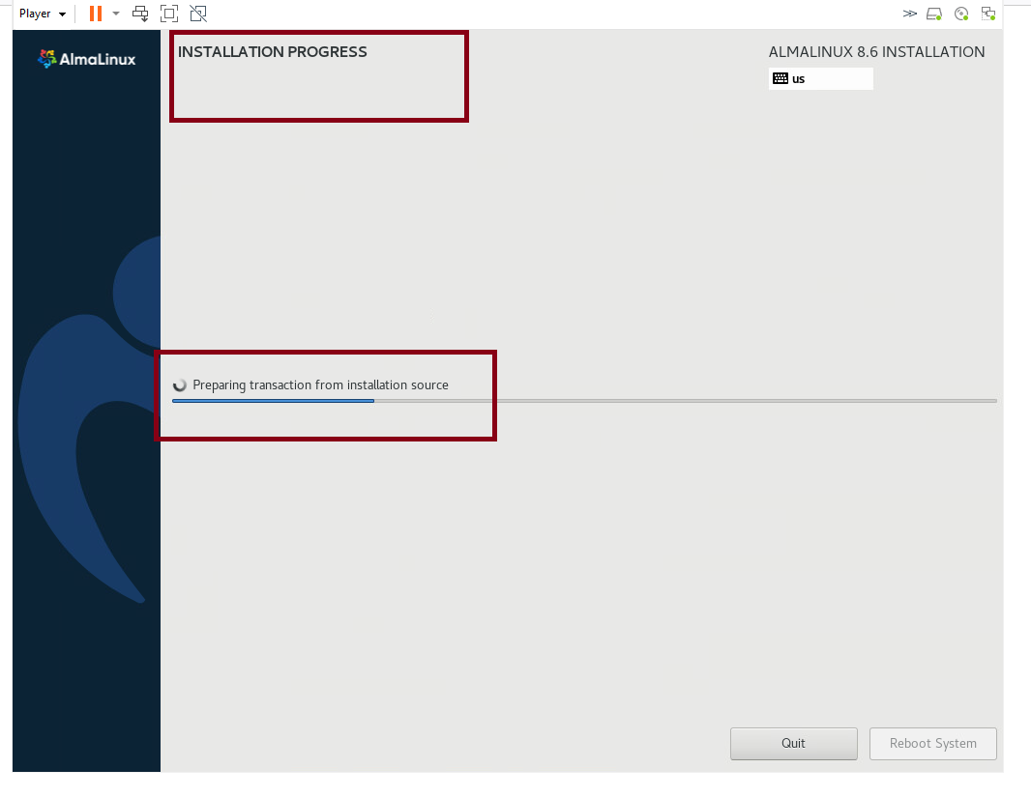
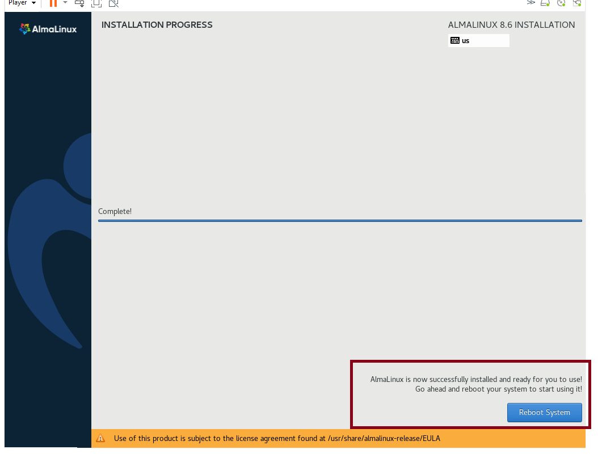
Step 12.
Select Begin Installation Process, wait for completion, and then reboot the system

Slide 38
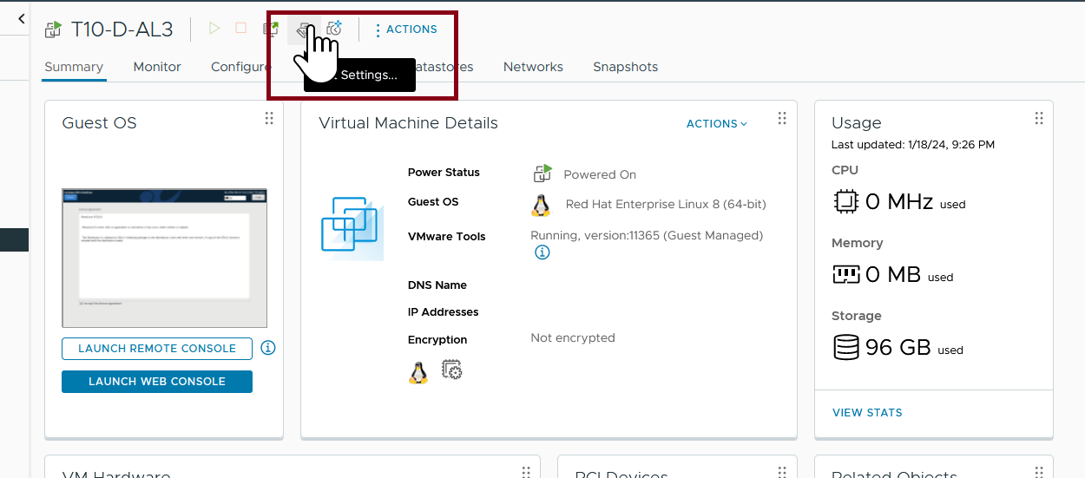
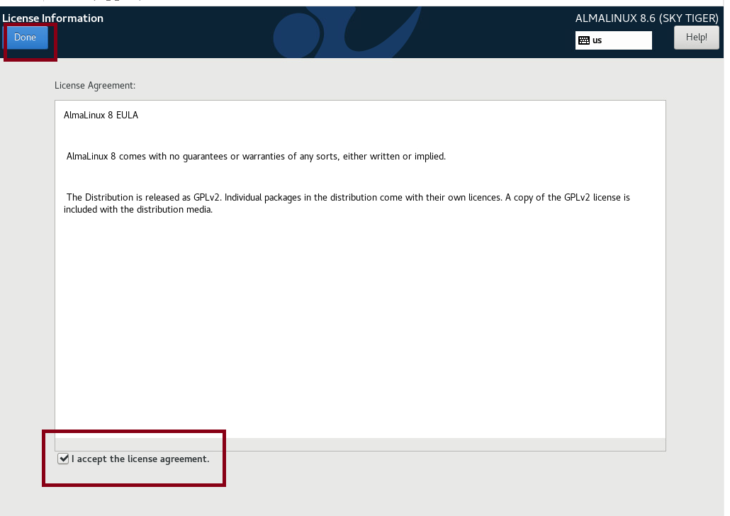
Step 13.
Accept the licensing agreement
Go Back to vSphere Client and select the Settings icon

Slide 39
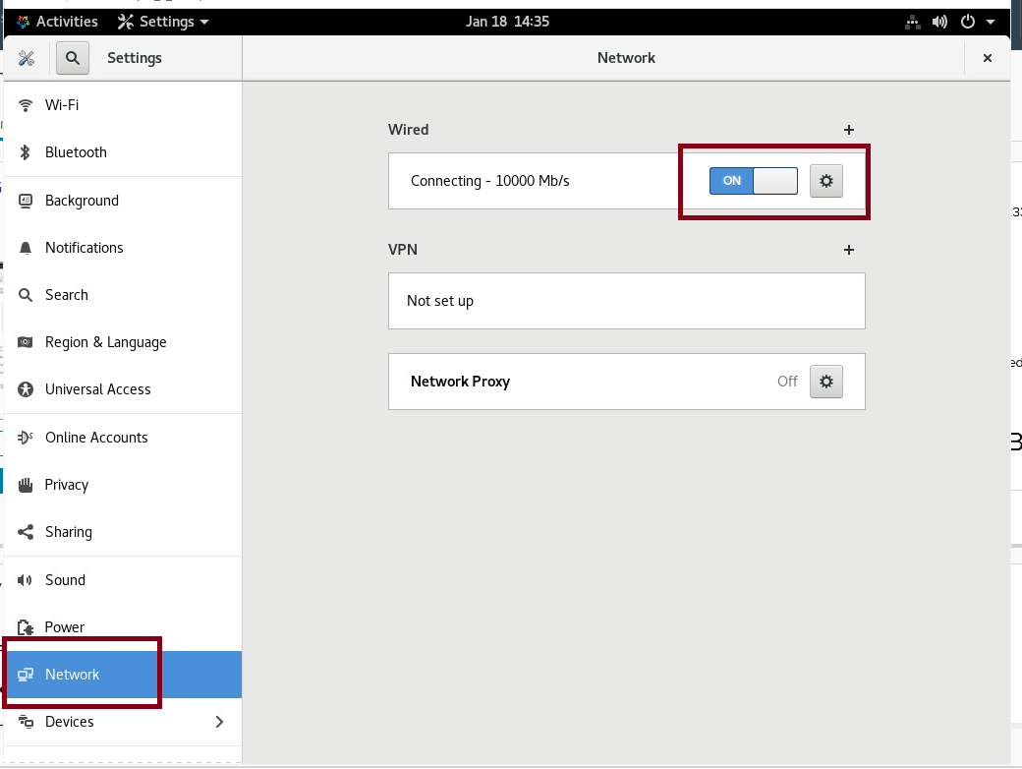
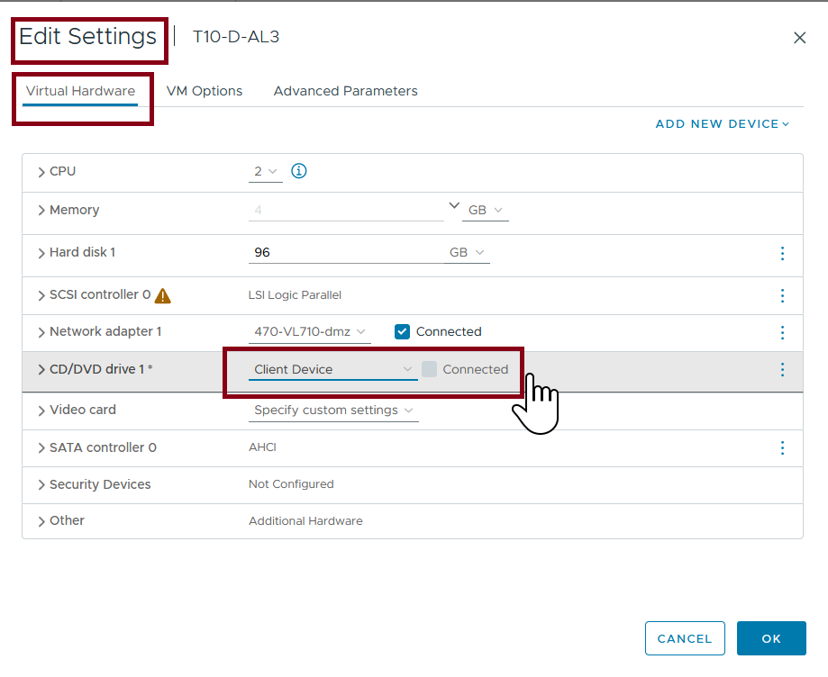
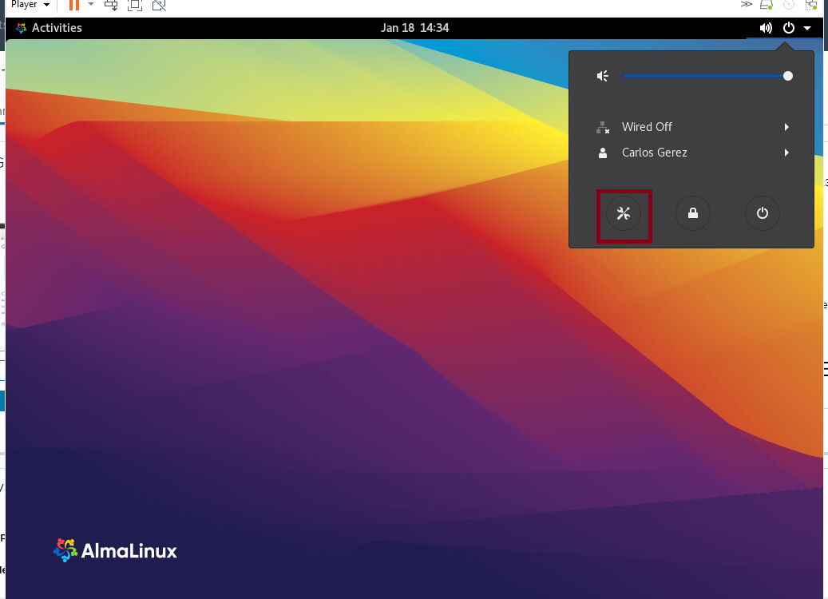
Step 14.
Under the Virtual Hardware tab > CD/DVD drive 1 use the dropdown arrow to remove the iso image and select Client Device
Go to the Alma Linux workstation and select settings from the dropdown then select network
Switch the Wired Selection on then click on the settings gear icon

Slide 40
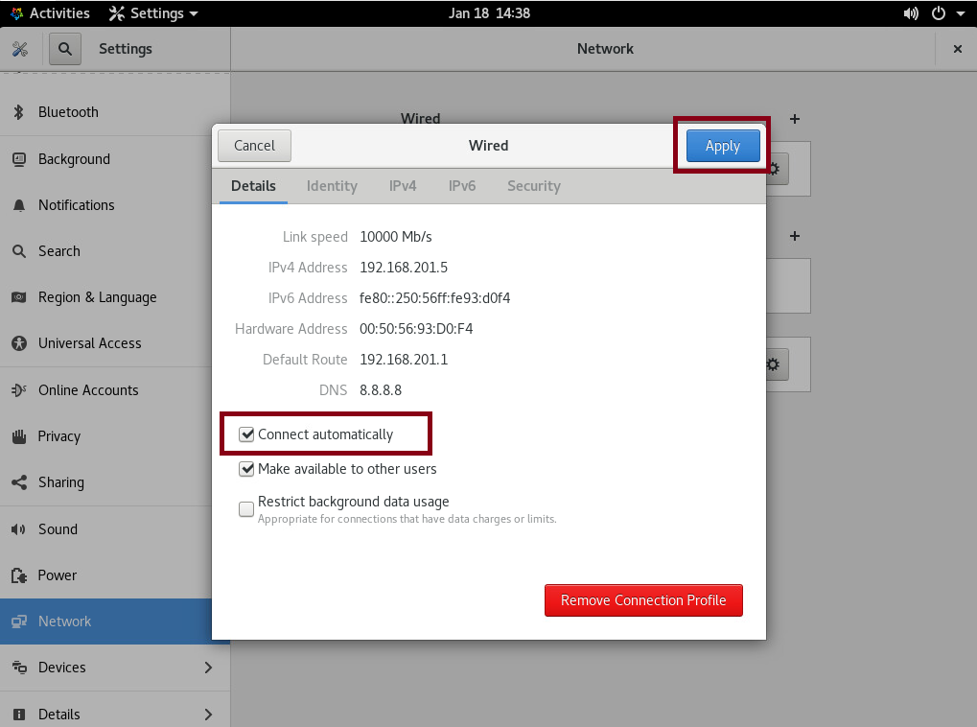
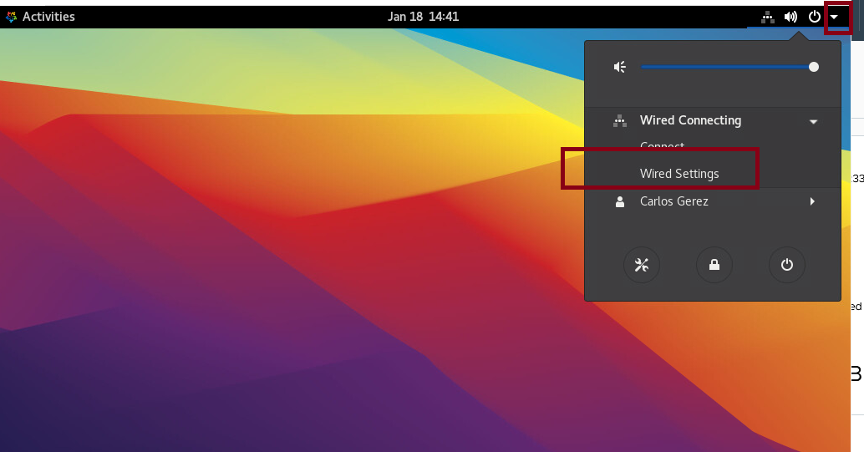
Step 15.
Check the Connect Automatically box and click Apply
Click on the Network Icon and go to Wired Settings

Slide 41



Step 16.
Under IPv4 settings change from Automatic (DHCP) to Manual
Make sure IP and DNS addressing is correct and click apply
Click on Settings and select Details

Slide 42




Step 17.
Click About and enter (machine name).localdomain to the Device Name Field
Click on Users Create a user with administrative authority for each team member and then one for The BYUI instructor using the username youngb and Name: Brigham Young

Slide 43


Step 18.
Under Settings Click on Settings>Privacy turn off Automatic Screen Lock
Under Settings>Power adjust Power Saving to desired specification

Slide 44
Challenges we faced

Slide 45

Inbound rule for Windows to accept ping requests.
Open Windows Defender Firewall

Slide 46

Inbound rule for Windows to accept ping requests.
Click on Inbound Rules then select File and Printer Sharing(Echo Request - ICMPv4 in)
Select Enable Rule

Slide 47

Inbound rule for Windows to accept ping requests.
The rule is now showing Enabled

Slide 48


Ping from machines inside DMZ successful.

Slide 49

Ping from machines inside DMZ successful.

Slide 50
Useful links for sharing passwords databases:
This is a video about how to sync KeePass using Google Drive in Android and Windows devices.
https://www.youtube.com/watch?v=-txzWZhZm9c&t=450s
Documentation about Google Drive synchronization between devices.
https://support.google.com/drive/answer/10838124?hl=en#zippy=%2Csync-a-folder-with-google-drive-or-google-photos%2Cdownload-drive-for-desktop

